Slide 1





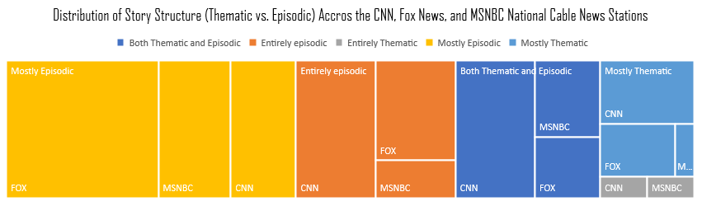
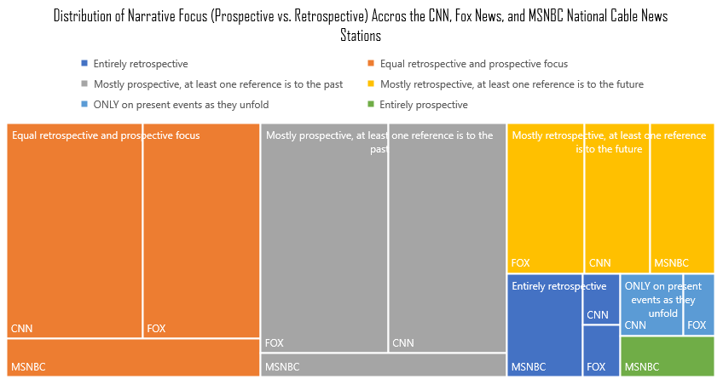
MAKING THE NEWS
MAKING THE NEWS
HOW STRUCTURAL CONSTRUCTION IN NEWS MEDIA CAN BE INDICATIVE OF NARRATIVE FOCUS & REPRESENTATIVE OF THEIR LARGER THEMATIC MESSAGES
THE ENGINEERS
THE BLUEPRINTS
THE PRODUCTS
FOX NEWS CNN MSNBC
37
38
20
STORIES
STORIES
STORIES
This analysis was conducted using video footage of news stories distributed across Fox News (37 stories), CNN (38 stories), and the MSNBC (20 stories) national cable news stations.
FOX NEWS CNN MSNBC
The distribution of the story structure of the three stations shows a relatively equal distribution between CNN and FOX who lean towards being more Episodic with MSNBC leaning more towards thematic story structures.
Scan the QR codes to watch a selected story from each story. For a shorter and more specific clips: watch the FOX NEWS story from 3:32 to 4:31, the CNN story from 0:00 to 1:08, and the MSNBC story from 7:06-9:00.
95% of stories across the three national stations were hosted/anchored by a Branded Program Host. The remaining 5% is represented by 5, or 13% of the CNN stories covered in this analysis.
95%
THE CONCLUSION
The 95 stories in this analysis covered 13 total programs across the three news stations
Episodic news frames focus on individual case studies or isolated events. Thematic news coverage focuses on trends over time and highlights both the contexts and the environment in which the event(s) in question occurred. Episodic frames are more likely to focus on the private realm as opposed to thematic frames which are more likely to center on the public realm. As a result of this episodic frames are going to focus on how to fix the problem of, or surrounding, an individual while thematic frames center on fixing conditions that led to the event. As a result, episodic news perceives viewers as consumers that need to be sold better information while Thematic views them as citizens and asks for better policies. With their focus on leaning towards Episodic and Prospective framing, FOX, CNN, and MSNBC predominantly create narratives centered on individual responsibilities rather than systemic ones.
Program | # Stories
THE LEAD WITH JAKE TAPPER | 15
ANDERSON COOPER 360 | 12
TUCKER CARLSON TONIGHT | 11
THE RACHEL MADDOW SHOW | 10
HANNITY | 9
THE 11TH HOUR WITH BRIAN WILLIAMS | 7
CNN TONIGHT | 6
THE FAULKNER FOCUS | 6
CNN NEWSROOM | 5
THE FIVE | 5
OUTNUMBERED | 4
DEADLINE: WHITE HOUSE WITH NICOLLE WALLACE | 3
THE FIVE BREAKING NEWS CONFERENCE | 2
The distribution of the narrative focus of stories between the three news stations shows the stations leaning towards equally focusing on both retrospective and prospective spins, or outlooks, to the stories with a leaning towards more prospective outlooks.
Mike Kombate

